Slide 1




HiMat: DiT-based Ultra-High Resolution SVBRDF Generation
Zixiong Wang¹ Jian Yang¹ Yiwei Hu² Miloš Hašan³
Beibei Wang†⁴
¹Nankai University ²Adobe Research ³NVIDIA ⁴Nanjing University
¹
²
³
⁴

Slide 2
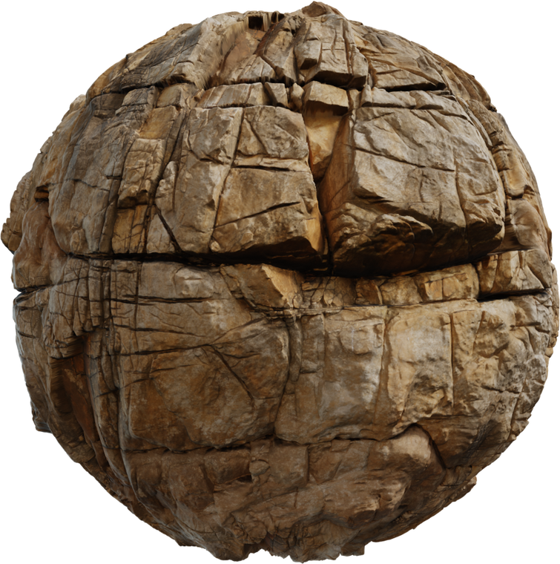
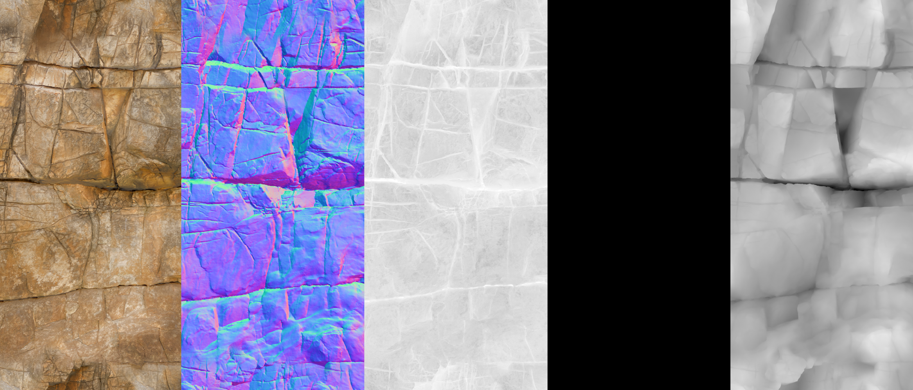
Background - What is SVBRDF
SVBRDF typically represents the parameters of the Cook-Torrance microfacet model
Albedo
Normal
Roughness
Metallic
Height
1
A reflectance model for computer graphics, Cook & Torrance 1982
https://polyhaven.com/a/marble_cliff_03
Notes:
Before introducing our paper, let’s first review some background.
SVBRDFs based on the Cook-Torrance microfacet model are widely used today.
In practice, SVBRDF usually contains several maps, such as albedo, roughness, and metallic maps. And if we want to represent more fine-scale geometric details, we can further add normal and height maps.

Slide 3
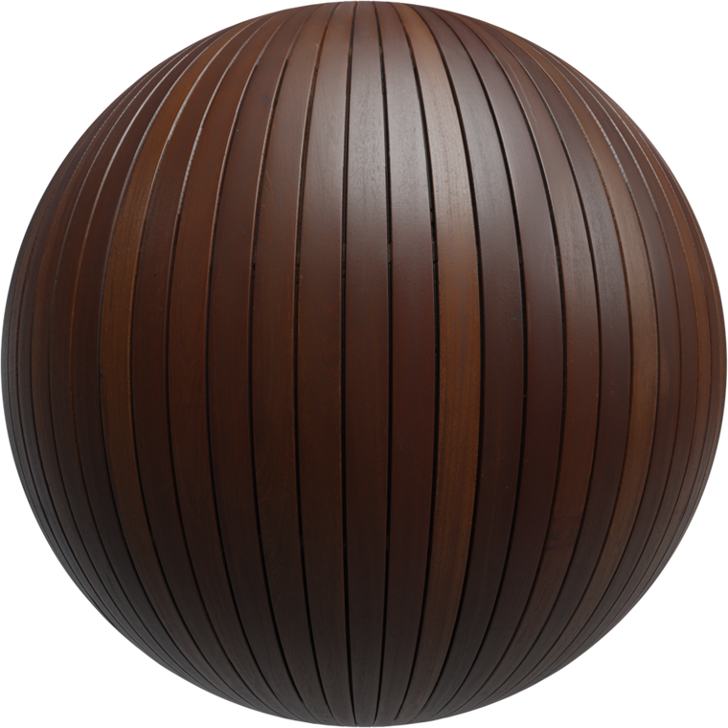
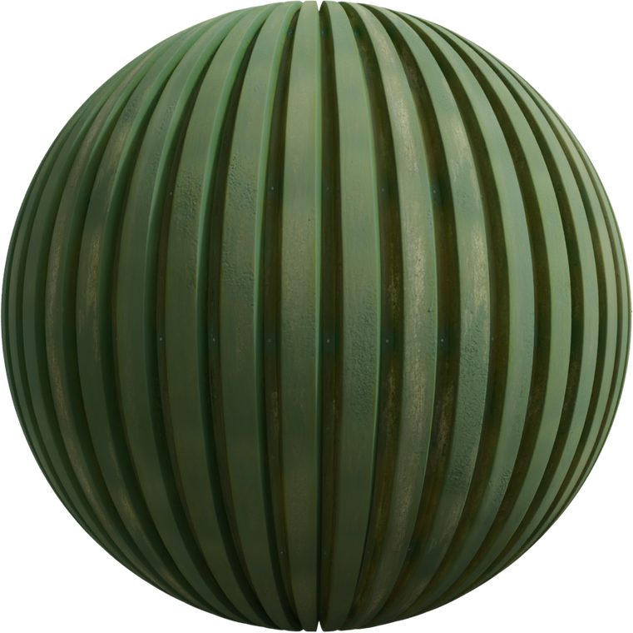
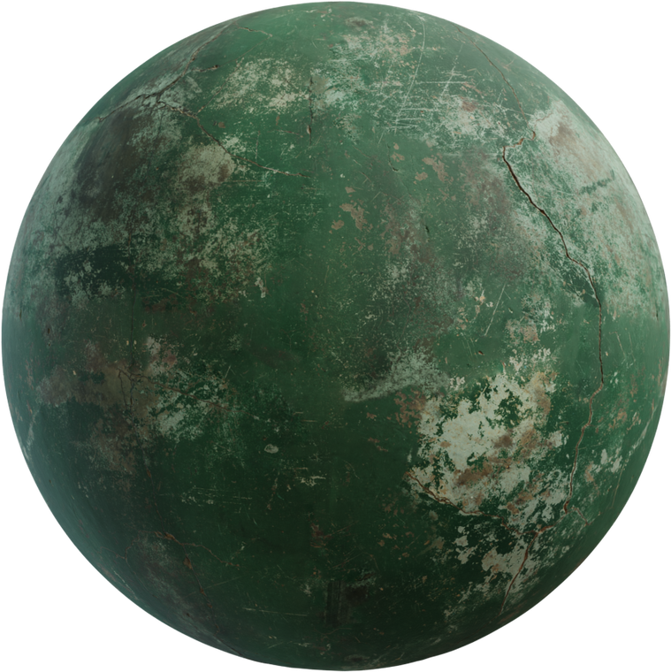
Background - What is SVBRDF
SVBRDF typically represents the parameters of the Cook-Torrance microfacet model
Stone
Wood
Metal
Concrete
A reflectance model for computer graphics, Cook & Torrance 1982
https://polyhaven.com/
2
Notes:
With these maps, we can represent a wide range of real-world materials, such as stone, wood, metal, and so on

Slide 4
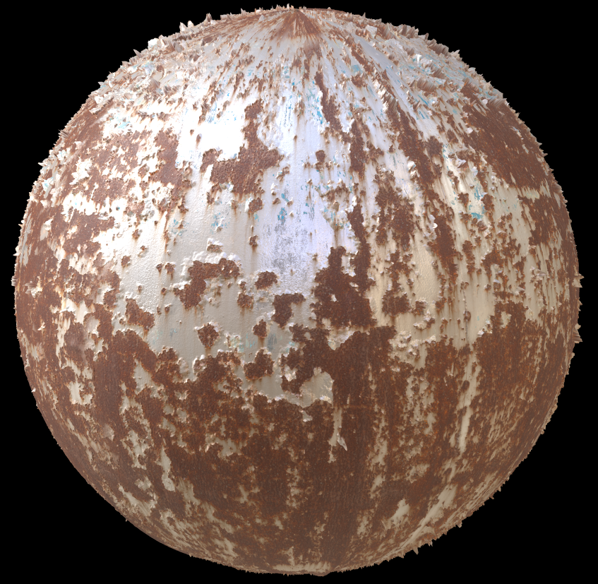

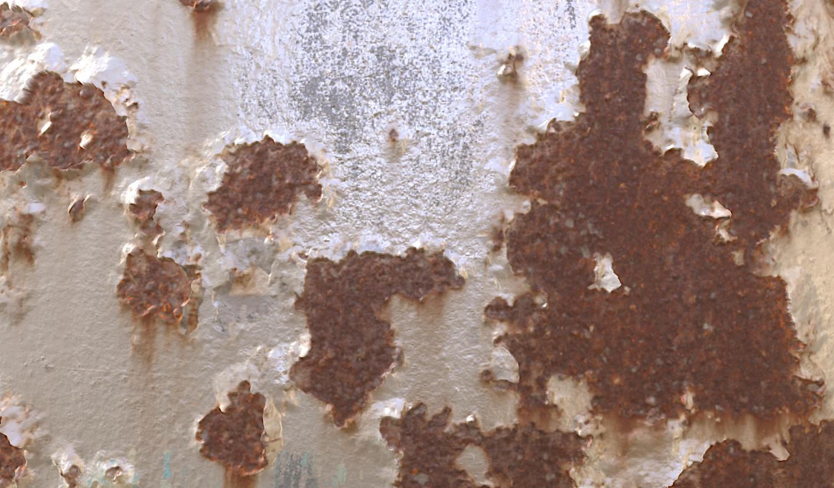
Background - Why use 4K SVBRDF in rendering?
Zoom 8x
1K
4K
4K resolution better preserves details and microstructure
3
https://polyhaven.com/a/rusty_metal_04
Notes:
Since these maps are essentially images, their resolution directly affects how much details we can preserve.
As shown here, lower-resolution maps tend to lose fine structures and details like peeling edges and rusty boundaries.
[Click] With 4K maps, these high-frequency microstructures are much better preserved enalbe close-up rendering

Slide 5
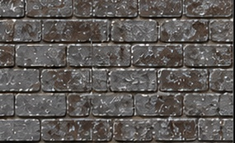
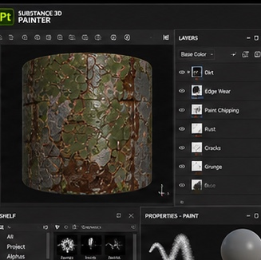
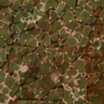
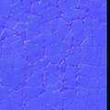

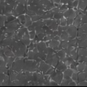
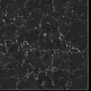
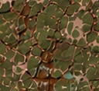
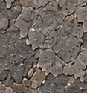
Background - Traditional 4K SVBRDF authoring
1. Reference & Analysis
2. Base Creation (macro.)
3. Detail Sculpting (micro.)
Authoring 4K SVBRDFs is time-consuming due to macro- and micro-scale details
https://www.youtube.com/watch?v=uxxliJba8m0
https://uts.thegnomonworkshop.com/learning-path-texturing-and-materials
https://80.lv/articles/001agt-tutorial-skin-texturing-for-real-time-characters
4
Notes:
However, creating 4K SVBRDF maps manually is very costly.
A typical workflow usually starts with analyzing reference images. Then, creating the base material maps to define the overall and macro deitals.
[Click] After that, they need to paint fine micro-scale details, for example, using brushes in tools like Substance 3D Painter.
[Click] But this is not a one-shot process. Artists often need to iterate many times to add macro and micro details
This motivates us to explore an automatic generation method.

Slide 6
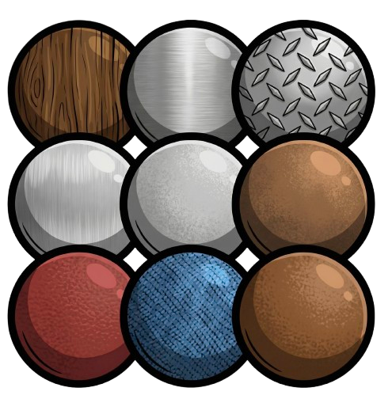


Related work - SVBRDF Generation
Text Input:
“Material prompt”
Generative models enable SVBRDF generation from text
5
Notes:
Recently, diffusion-based generative methods have made SVBRDF generation much more accessible.
These methods can take different types of input signals, such as text prompts, and automatically generate multiple category materials.

Slide 7
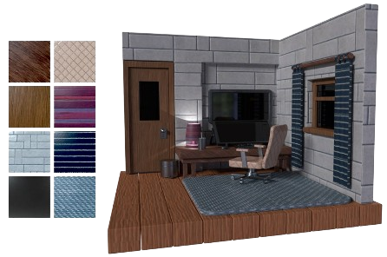
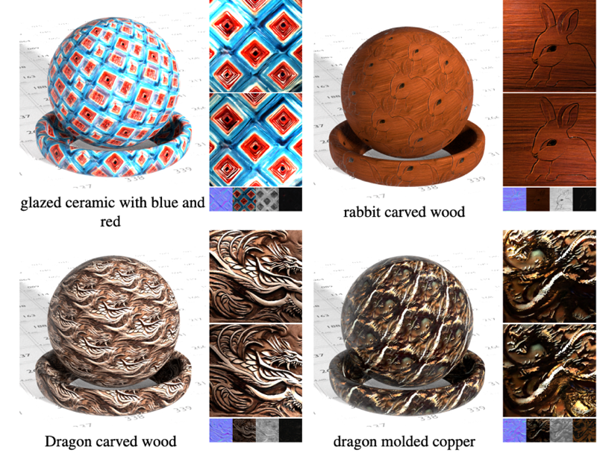
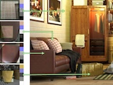
Related work - SVBRDF Generation
MatFuse
Vecchio et al. [2024]
ReflectanceFusion
Xue et al. [2024]
MaterialPicker
Ma et al. [2025]
Existing methods primarily target low-resolution materials (typically 512×512)
MatFuse: Controllable Material Generation with Diffusion Models, Vecchio et al. 2024
6
ReflectanceFusion-Diffusion-based-text-to-SVBRDF-Generation, Xue et al. 2024
MaterialPicker: Multi-Modal DiT-Based Material Generation, Ma et al. 2025
Notes:
Several recent works have explored text-driven SVBRDF generation, including MatFuse, ReflectanceFusion, and MaterialPicker.
[Click] However, most existing methods still focus on low-resolution outputs, around 512 by 512, which is not enough for close-up rendering.

Slide 8
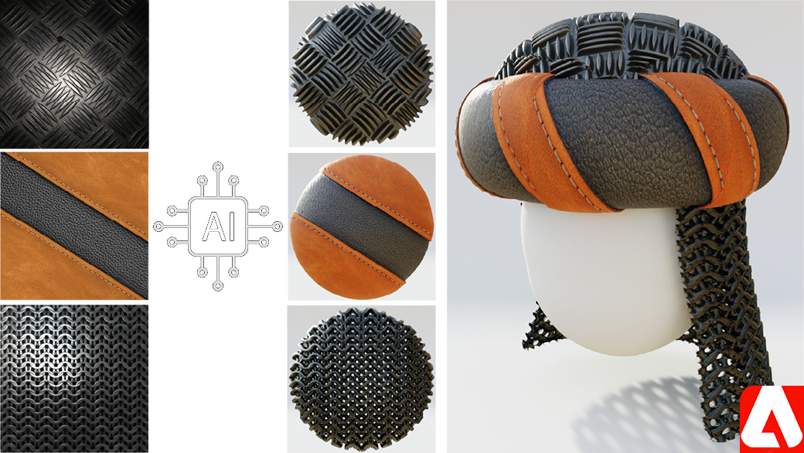
Related work - 4K SVBRDF Generation
Multi-stage cascaded upsampling suffers from low efficiency
Limited material training data restricts generalization
MatGen
Vecchio et al. [2024]
7
ControlMat: Controlled Generative Approach to Material Capture, Vecchio et al. 2024
Notes:
There has also been work targeting 4K material generation, such as MatGen.
[Click] It uses a multi-stage cascaded upsampling pipeline, starting from a low-resolution output and gradually refining the maps to 4K resolution. This multi-stage process is relatively inefficient.
[Click] Also, because it is trained on a limited material dataset from scratch, its generation diversity is still limited.

Slide 9
Resolution v.s. Speed
4K²
MatGen
HiMat
4K² (cascade, slow)
4K² · fast · diverse
1K²
RESOLUTION
512²
MatFuse
512²
256²
MaterialPicker
ReflectanceFusion
256²
256²
slow
SPEED
fast
8
Speed uses A100-equivalent time from FP16/BF16 throughput normalization
Notes:
Based on these limitations, our goal is clear.
As shown in this figure, many existing methods are fast, but their output resolution is relatively low. MatGen reaches 4K resolution, but it is slower because of the cascaded upsampling pipeline.
[Click] So with HiMat, we aim to achieve 4K resolution, efficient, and diverse.

Slide 10
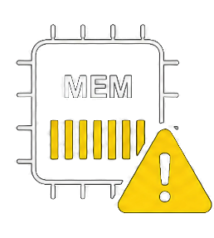

Key challenges
1. Resolution Scaling Bottleneck
2. Cross-Map Alignment
4096²
High memory cost (OOM)
✗
Albedo
Normal
Roughness
Metallics
Height
Long generation time
4096² resolution pushes memory and runtime limits
Must align across maps at 4K resolution
9
Notes:
To achieve this, there are two key challenges. [Click]
First, resolution scaling bottleneck.
Our target is 4096 × 4096. This is a huge jump in the number of pixels. [Click] So if we simply scale up the generation process, the memory cost quickly explodes — and the GPU just says “no” with OOM errors
[Click] Besides memory, the generation time also becomes much longer since we have to generate so much pixels
[Click] Second, cross-map alignment. [Click] A single SVBRDF contains multiple maps. These maps must stay pixel-aligned at 4K resolution; otherwise, leading to incorrect material

Slide 11

Key challenges: Resolution scaling
Traditional latent diffusion pipeline
4096²
VAE
8× compress
DiT
O(N²) attention
512²
image space
Latent space
Softmax attention is quadratic
Latent tokens are still too many
High-Resolution Image Synthesis with Latent Diffusion Models, Rombach et al. 2022
10
Scalable Diffusion Models with Transformers, Peebles and Xie. 2023
Notes:
[Click] Let’s focus on the Resolution Scaling issue first. [Click]
In traditional latent diffusion, the 4K image is first compressed by a VAE, usually with 8 times compresstion. [Click]Then, a diffusion model such as DiT processes the latent representation using softmax attention.
[Click] However, even after compression, the latent maps is still very large, and softmax attention has quadratic complexity with respect to the number of tokens.
[Click] As a result, directly applying standard latent diffusion at 4K becomes impractical.

Slide 12
Our design: Resolution scaling
Our pipeline
4096²
VAE
8× compress
DC-AE
32× compress
DiT
O(N²) attention
128²
512²
image space
Latent space
DC-AE for aggressive latent compression
Deep Compression Autoencoder for Efficient High-Resolution Diffusion Models, Chen. 2025
11
Notes:
To address this issue, we introduce two designs.
[Click] First, we replace the standard VAE with DC-AE. Instead of compressing the 4K input by only 8 times, DC-AE compresses it by 32 times.
This greatly reduces the number of latent tokens to save the memmoery

Slide 13
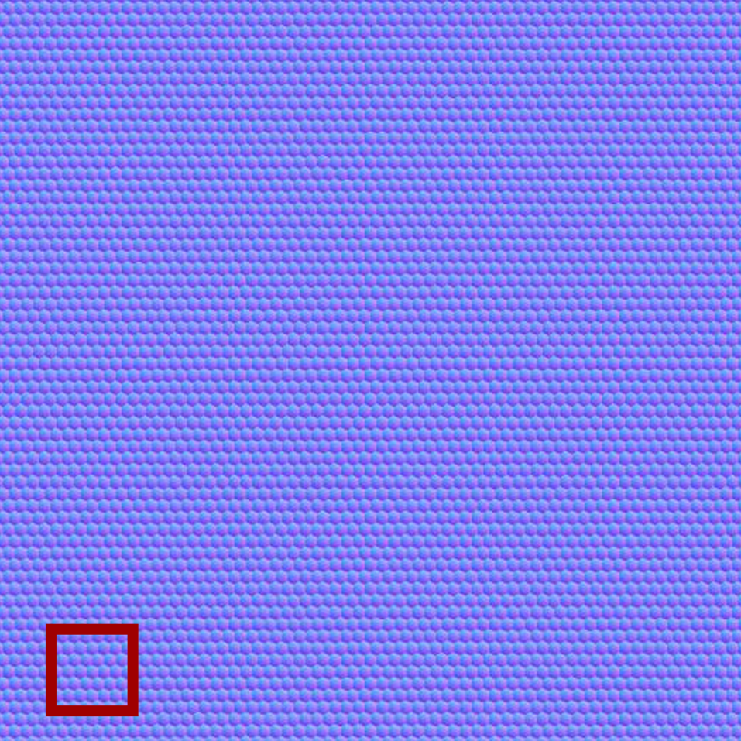
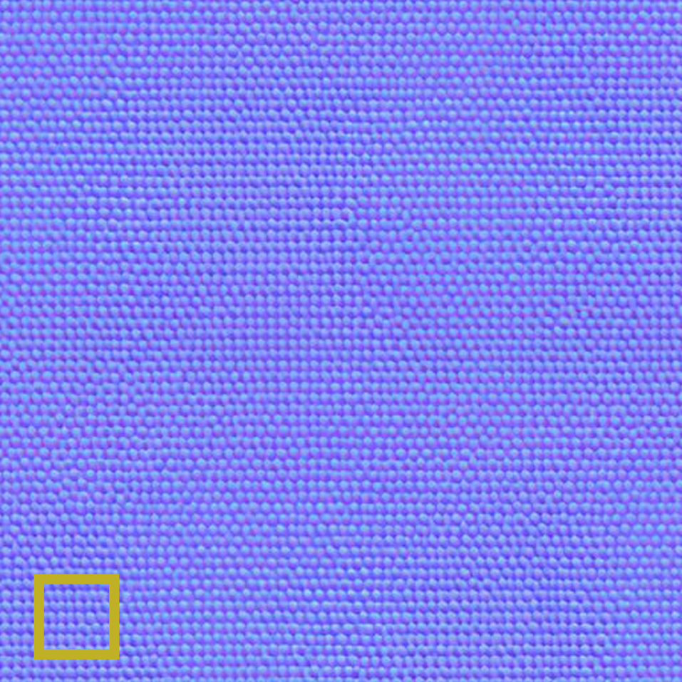
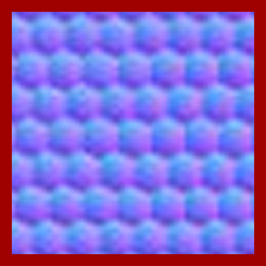
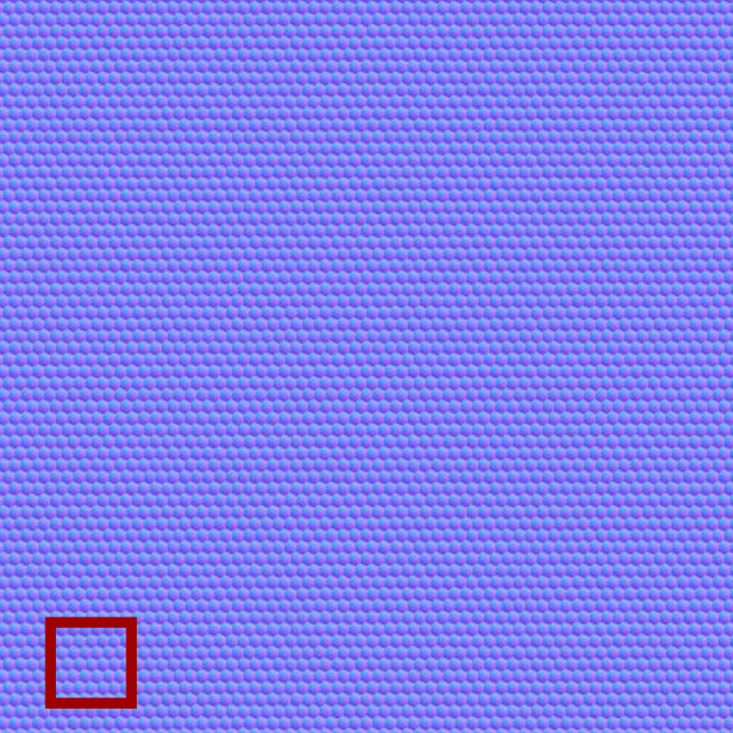

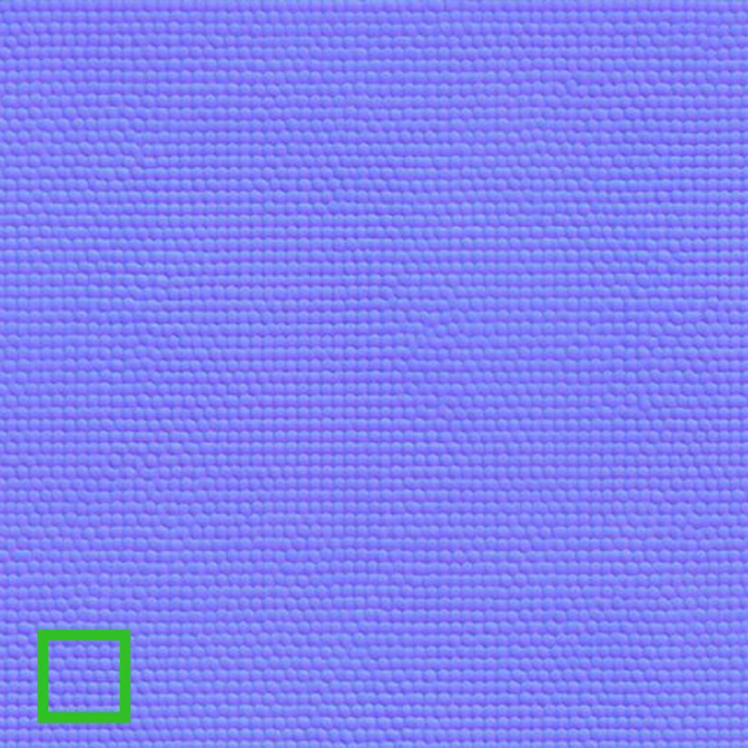
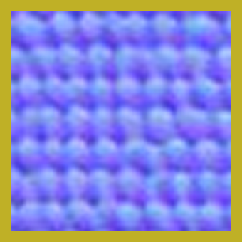
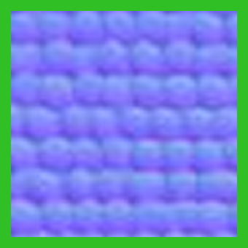
Our design: Resolution scaling
Problem: Vanilla DC-AE is trained on RGB natural images, not material maps.
Original Image DC-AE Reconstruction DC-AE + Fine-tuning
Reconstruction
Original Image DC-AE Reconstruction
Fix: Fine-tune DC-AE on SVBRDF data to preserve high-frequency map structure.
12
Notes:
This design may look very simple. But we find with such aggressive compression, the model starts to miss important spatial patterns
As shown here, the vanilla DC-AE reconstruction can lose or distort these fine structures of normal maps
[Click] To address this, we fine-tune DC-AE on SVBRDF data.
After fine-tuning, the reconstruction preserves the map structure much better

Slide 14
Our design: Resolution scaling
Our pipeline
4096²
DC-AE
32× compress
DiT
O(N²) attention
Linear DiT
O(N) attention
128²
image space
Latent space
DC-AE for aggressive latent compression
Linear attention for scalable 4K generation
13
Deep Compression Autoencoder for Efficient High-Resolution Diffusion Models, Chen et al. 2025
SANA: Efficient High-Resolution Image Synthesis with Linear Diffusion Transformer, Xie et al. 2025
Notes:
Next, we replace the standard softmax-attention DiT with a linear-attention DiT. [Click]

Slide 15
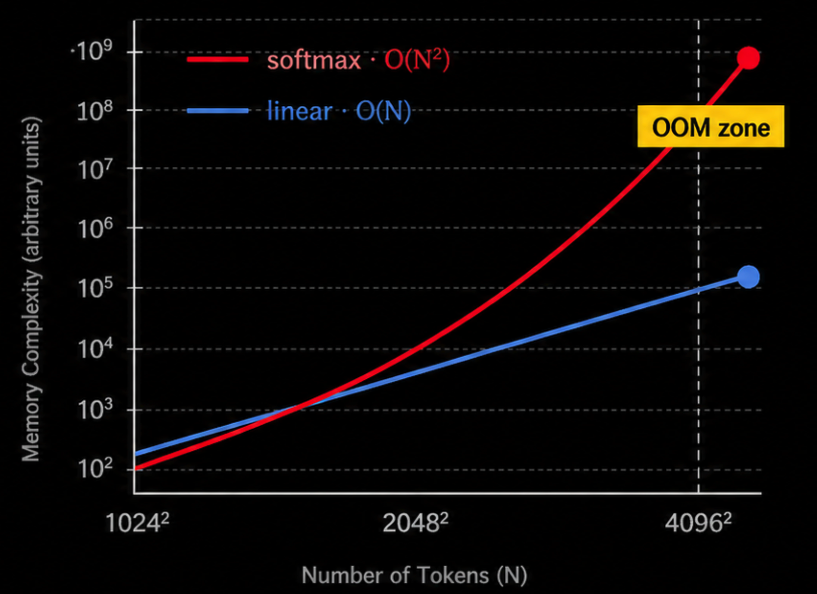
Our design: Resolution scaling
Replace softmax attention with linear attention
O(N) memory, instead of O(N²)
Avoids OOM at 4K resolution
14
Notes:
Linear attention reduces the complexity to approximately linear and avoid OOM at 4K

Slide 16
Key challenges
1. Resolution Scaling Bottleneck
2. Cross-Map Alignment
4096²
High memory cost (OOM)
✗
Albedo
Normal
Roughness
Metallics
Height
Long runtime
4096² resolution pushes memory and runtime limits
Must align across maps at 4K resolution
15
Notes:
Now let‘s talk about the second challenge, cross-map alignment. [Click]

Slide 17
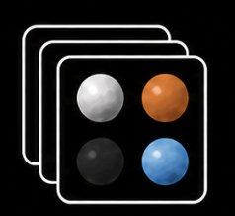
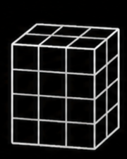
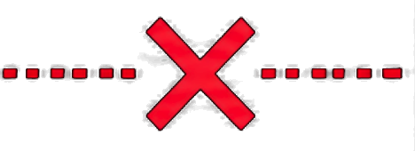
Key challenges: Cross-Map alignment
Existing alignment method – VAE-Based
Pretrained DiT
SVBRDFs (Multi-channels)
Custom VAE
(trained from scratch)
Unique latent space
Latent space not aligned
Difficult to leverage pretrained model priors, resulting in limited diversity
16
MatFuse: Controllable Material Generation with Diffusion Models, Vecchio et al. 2024
ControlMat: A Controlled Generative Approach to Material Capture, Vecchio et al. 2024
Notes:
Just like what we did for the first challenge, let’s first analyze how existing methods handle this challenge.
[Click] Some methods, such as MatFuse and MatGen, train a custom VAE from scratch for multi-channel SVBRDF maps.
This can help address the alignment issue. [Click] However, since this latent space is not aligned with the latent space of pretrained image models, it becomes difficult to leverage their image priors to improve generation diversity.

Slide 18
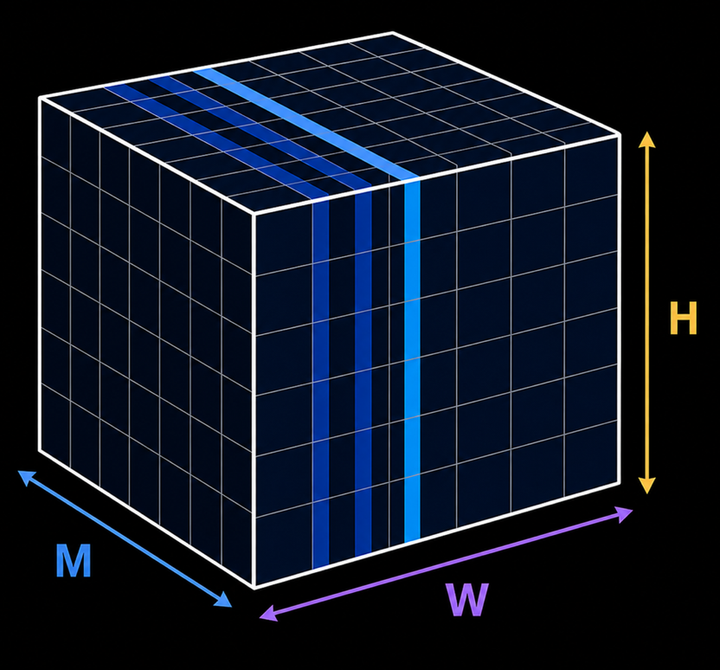
Key challenges: Cross-Map alignment
Existing alignment method – Attention-Based
Sequence Length
=
H
× W ×
M
Pretrained DiT
H:
Height
W:
Width
SVBRDFs (Multi-channels)
M:
Number of maps
Excessive token count for attention
Full-dimensional attention is impractical at 4K (resources limited)
17
MaterialPicker: Multi-Modal DiT-Based Material Generation, Xue et al. 2025
Notes:
Another type of method, like MaterialPicker, tries to use a pretrained generation model directly
[Click] To do that, it adds an additional 3D attention layer over both the image dimensions and the map dimensions.
This leads to a long sequence length, that is H by W by M.
While it allows the model to align different maps, the token count becomes very large, making it difficult to scale to high-resolution outputs.

Slide 19

Our design: Cross-Map alignment
Key Insight: PBR maps can form short sequences by map count.
We can use 1D Conv to capture cross-map patterns
A
N
R
M
M
H
M:
Number of maps
18
Notes:
To address this issue, our key insight is that PBR maps naturally form a very short sequence.
As shown on the right, instead of 3D dims sequences, we convert the multiple PBR maps at each pixel into a short 1D sequence along the M axis.
[Click] With this short sequence, we can use a lightweight 1D convolution to capture local patterns efficiently.

Slide 20

Our design: Cross-Map alignment
Key Insight: PBR maps can form short sequences by map count.
We can use 1D Conv to capture cross-map patterns
A
N
1D Conv
Local alignment Capture map-wise pattern
Low overhead Few parameters, hardware-friendly
R
M
H
18
Notes:
In this way, the 1D conv can capture the cross-map information like this [click][click][click]
[Click] This design not only improves alignment with map-wise pattern, but also with low overhead since conv can work with fewer parameters and more hardware firendily.

Slide 21
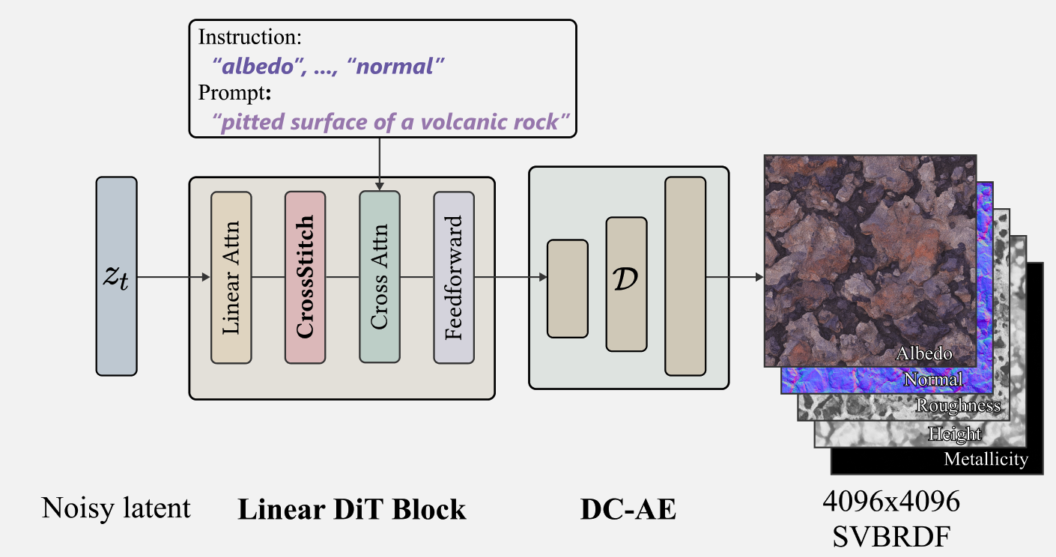
Our generation pipeline
01
Map-specific instructions guide
different map generation
02
CrossStitch: 1D Conv
inserted into DiT blocks to use pretrained prior
20
Notes:
Here is the overall design of our method.
Starting from a noisy latent z, we use the Linear DiT backbone to generate the final latent representation
We use specific instructions to decides which map is generated.
[Click] Inside each DiT block, we insert our 1D conv module named CrossStitch to align the maps and fine-tune the pretrained model to improve the diversity.
Finally, the generated latent is decoded by the fine-tuned DC-AE into SVBRDF maps.

Slide 22
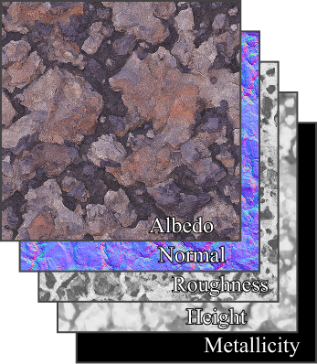
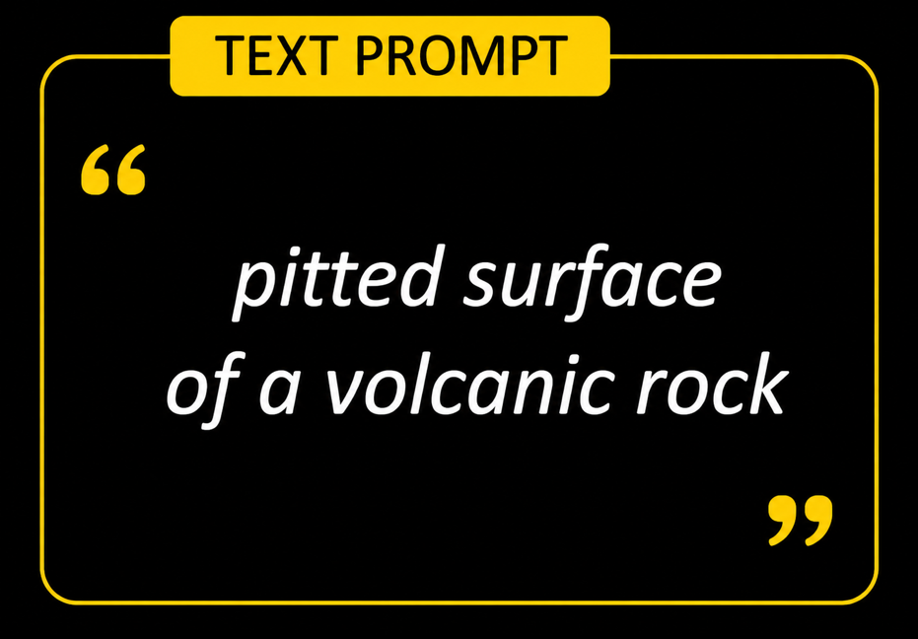
Our generation pipeline
Generating...
HiMat
Generation Process
HiMat: 90s for 4K SVBRDF generation on RTX 4090
19
0s
90s
Notes:
Thanks to our design, the full 4K SVBRDFs can be generated in about 90 seconds on RTX 4090.

Slide 23
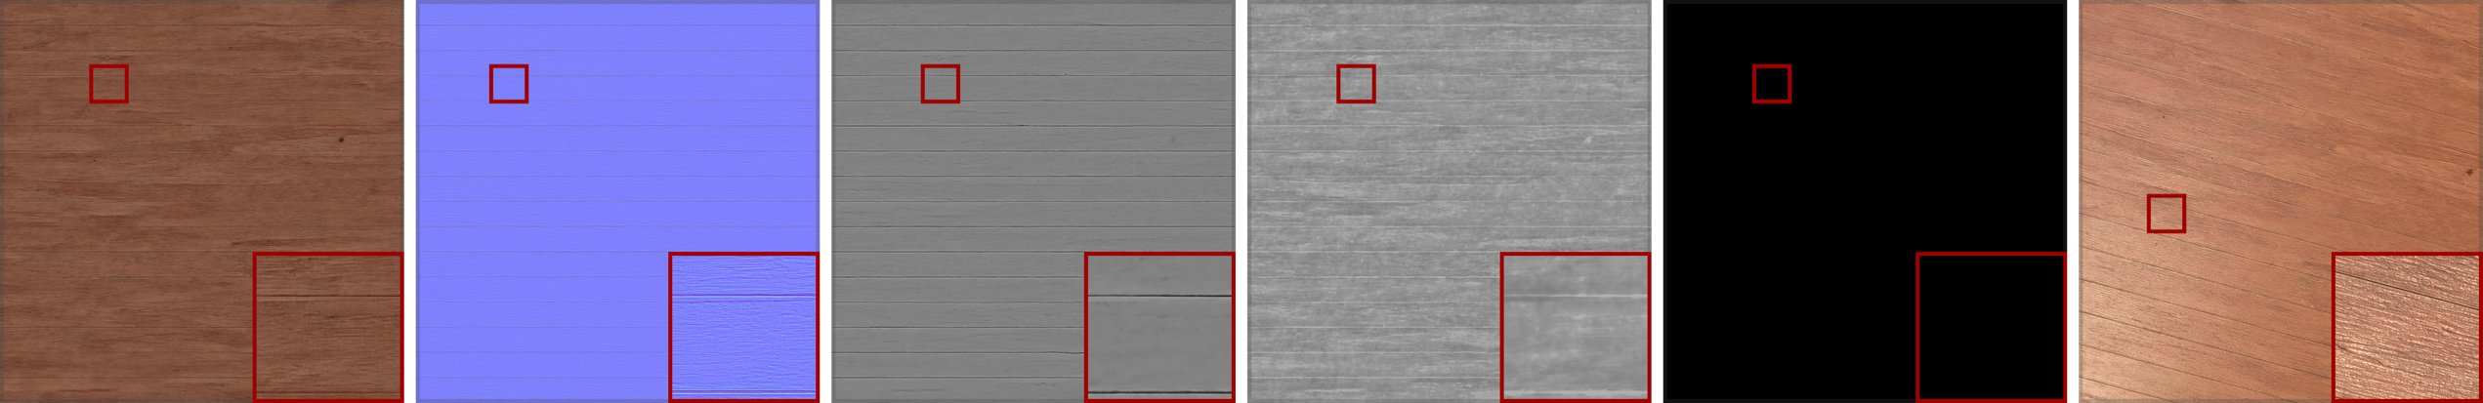
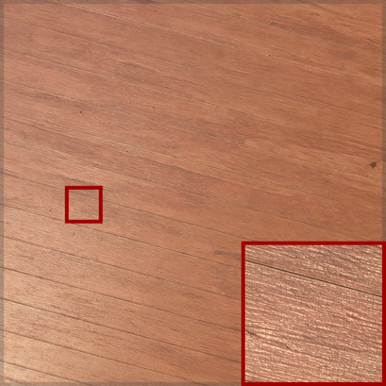
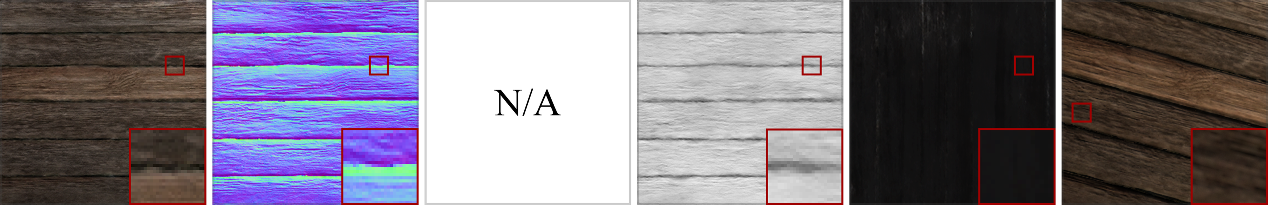
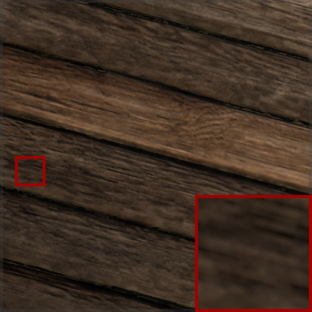
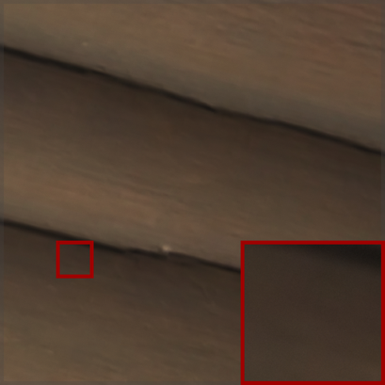
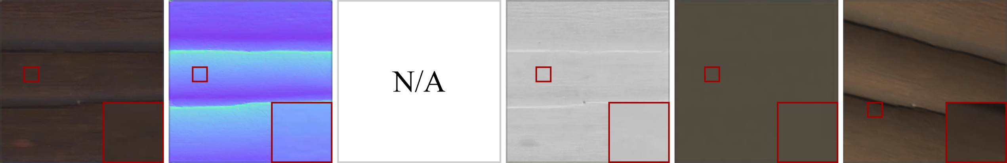
Results - Text2SVBRDF
Albedo
Normal
Height
Roughness
Meta./Spec.
Rendering
Text prompt:“Wooden plank panel”
Ours
(4096x4096)
ReflectanceFusion
(256x256)
MatFuse
(512x512)
21
Notes:
Here we show some results. We compare our model to previous work, MatFuse and RelfeactionFusion.

Slide 24
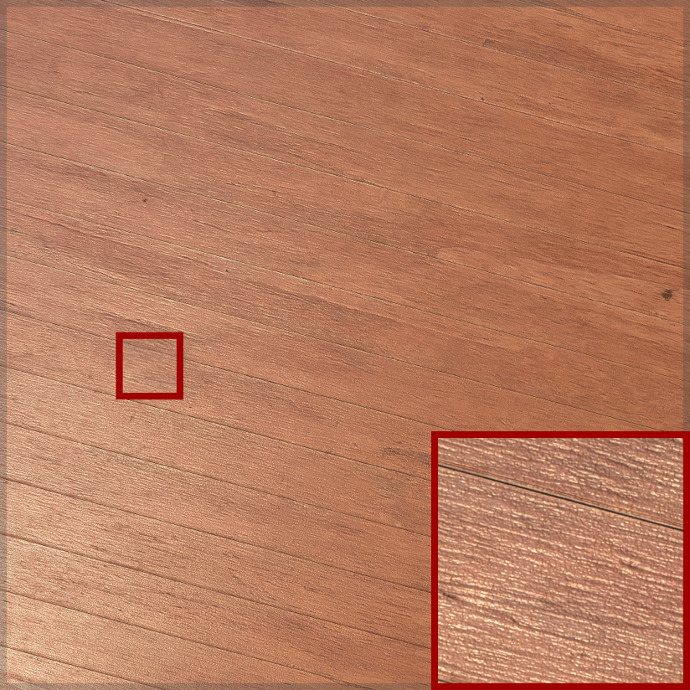

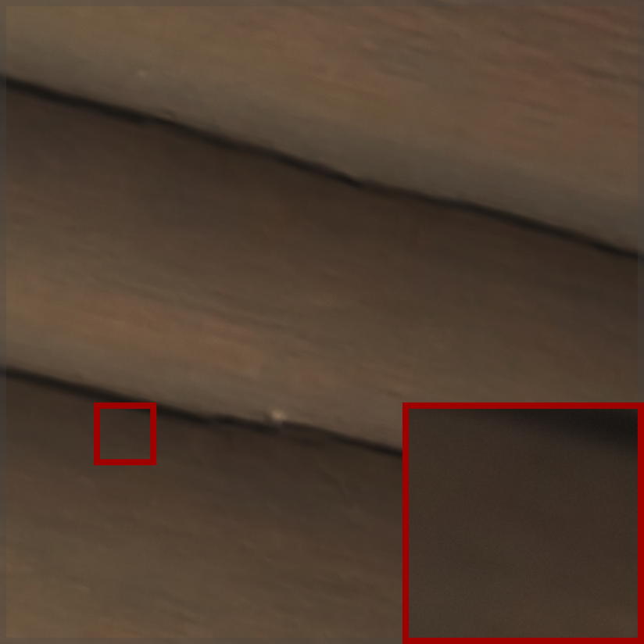
Results - Text2SVBRDF
Text prompt:“Wooden plank panel”
Ours
(4096x4096)
ReflectanceFusion
(256x256)
MatFuse
(512x512)
Ours generates higher-resolution textures with sharper details
22
Notes:
Now let’s zoom into the rendered results.
Our method produces higher-resolution textures with sharper details and more realistic appearance.

Slide 25
Results - Text2SVBRDF
Text prompt:“Wooden plank panel”
22
Notes:
And we can keep zooming in on our results for close-up rendering.

Slide 26
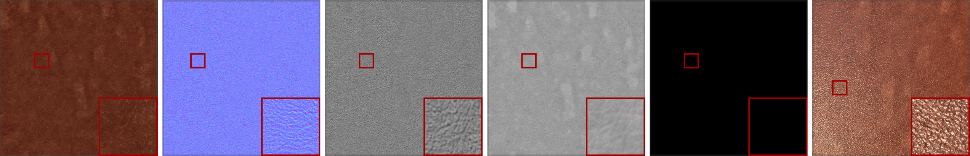
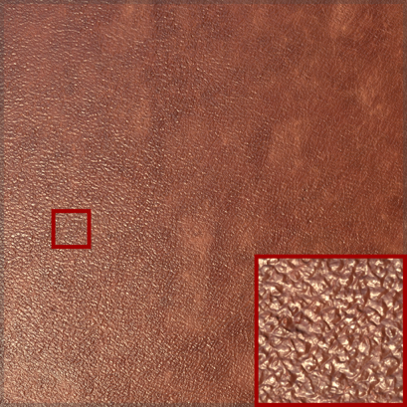
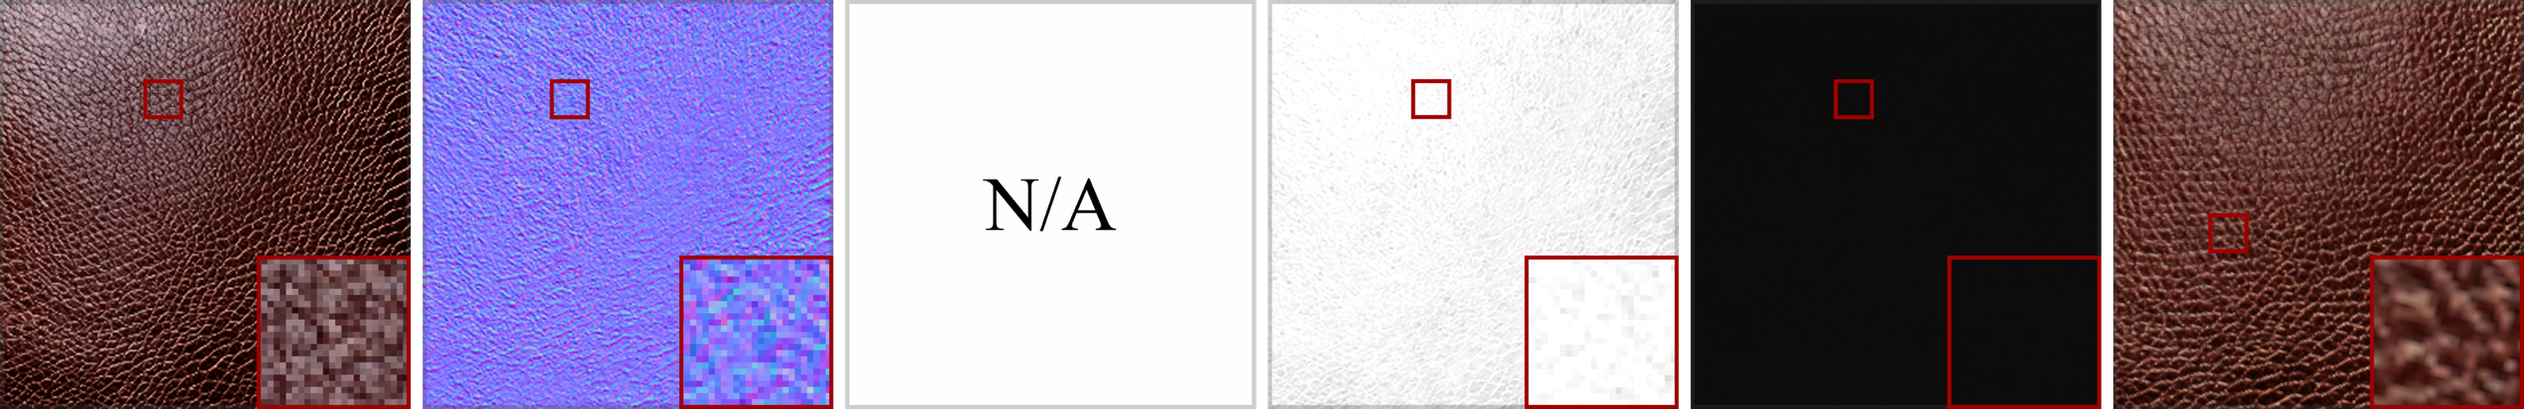
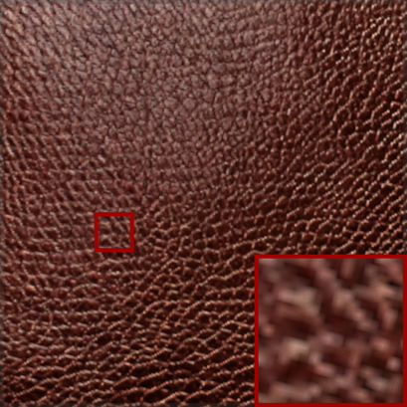
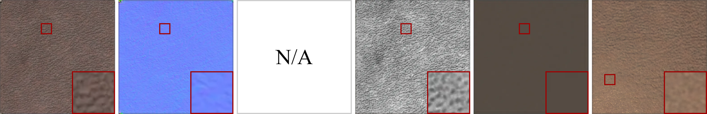
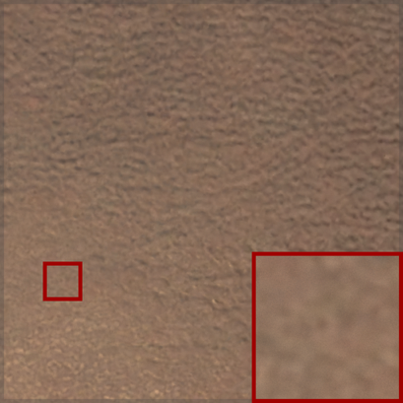
Results - Text2SVBRDF
Albedo
Normal
Height
Roughness
Meta./Spec.
Rendering
Text prompt:“Brown leather”
Ours
(4096x4096)
ReflectanceFusion
(256x256)
MatFuse
(512x512)
23
Notes:
And this is another case for leather
One thing to notice is that ReflectanceFusion suffers from light-baking artifacts, so some specular are incorrectly baked into the albedo map.

Slide 27



Results - Text2SVBRDF
Text prompt:“Brown leather”
Ours
(4096x4096)
ReflectanceFusion
(256x256)
MatFuse
(512x512)
Ours generates higher-resolution textures with sharper details and more realistic
24
Notes:
And let’s zoom in on rendering results again to see the differences

Slide 28
Results - Text2SVBRDF
Text prompt:“Brown leather”
24
Notes:
Still, we can zoom into our results to see some details

Slide 29



Results - Text2SVBRDF
A weathered plaster surface
A painted, corroded metal surface
Metallic dragon scales
25
Notes:
Here more cases of our method, from plaster metal and fantcy draong scales

Slide 30
Results - Text2SVBRDF
25
Notes:
We can move close

Slide 31
Results - Text2SVBRDF
25
Notes:
and closer

Slide 32










Results - Intrinsic decomposition [Hypersim]
Albedo
Normal
Irradiance
Cross-map interaction
Captures dependencies among intrinsic maps
Better alignment leading to clean prediction
RGB→X
w/ CrossStitch
RGB→X
w/o CrossStitch
Input image
Ground truth
26
Hypersim: A Photorealistic Synthetic Dataset for Holistic Indoor Scene Understanding, Mike et al. 2021
RGB↔X: Image decomposition and synthesis using material- and lighting-aware diffusion models, Zeng et al. 2024
Notes:
Since 1D conv models interact between multiple maps, it can also be applied beyond SVBRDF generation.
Here, we evaluate it on intrinsic decomposition, where the model predicts albedo, normal, and irradiance from a single RGB image.
We compare RGB-to-X models with and without CrossStitch.
[Click] As shown, CrossStitch produces cleaner predictions and better alignment with the ground truth.
This suggests that CrossStitch has potential for broader multi-map prediction tasks.

Slide 33
Conclusion
HiMat enables efficient 4K SVBRDF generation
DC-AE + linear-attention DiT makes ultra-high-resolution practical
CrossStitch enforces cross-map consistency in a lightweight manner
HiMat achieves high resolution, diversity, and practical runtime on consumer GPUs
Notes:
To conclude, we present HiMat, an efficient framework for 4K SVBRDF generation.
[Click] First, HiMat enables efficient ultra-high-resolution material generation at 4K resolution.
[Click] To make this practical, we combine DC-AE with a linear-attention DiT backbone, which greatly reduces the memory and runtime cost for high-resolution synthesis.
[Click] We also introduce CrossStitch to improve inter-map consistency in a lightweight manner
[Click] As a result, HiMat achieves high resolution, strong diversity, and practical runtime on consumer GPUs.

Slide 34

https://www.bearprin.com/publications/himat/
zixiong_wang@outlook.com
Notes:
Thank you for your listening.

